Slide 1
The Physical Layer
Chapter 2

Slide 2
Theoretical Basis for Data Communication
Fourier analysis
Bandwidth-limited signals
Maximum data rate of a channel

Slide 3
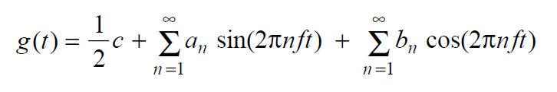
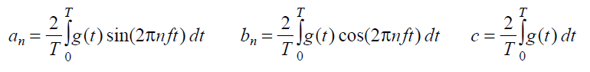
Fourier Analysis
We model the behavior of variation of voltage or current with mathematical functions
Fourier series is used
Function reconstructed with

Slide 4
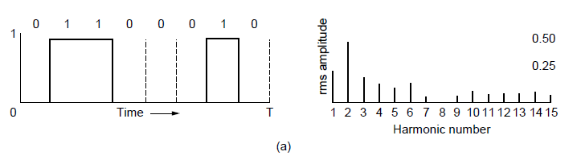
Bandwidth-Limited Signals (1)
A binary signal and its root-mean-square Fourier amplitudes.

Slide 5
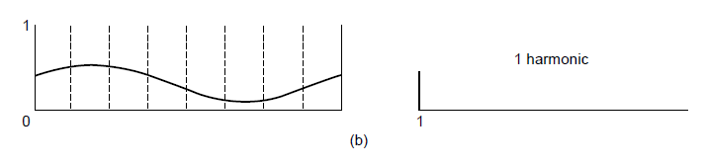
Bandwidth-Limited Signals (2)
(b)-(e) Successive approximations to the original signal.

Slide 6
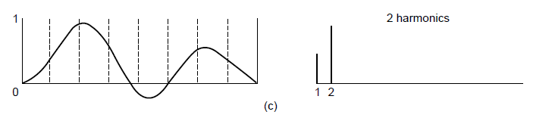
Bandwidth-Limited Signals (3)
(b)-(e) Successive approximations to the original signal.

Slide 7
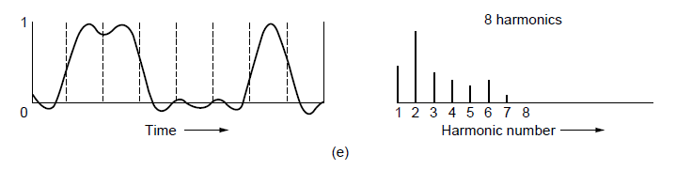
Bandwidth-Limited Signals (5)
(b)-(e) Successive approximations to the original signal.

Slide 8
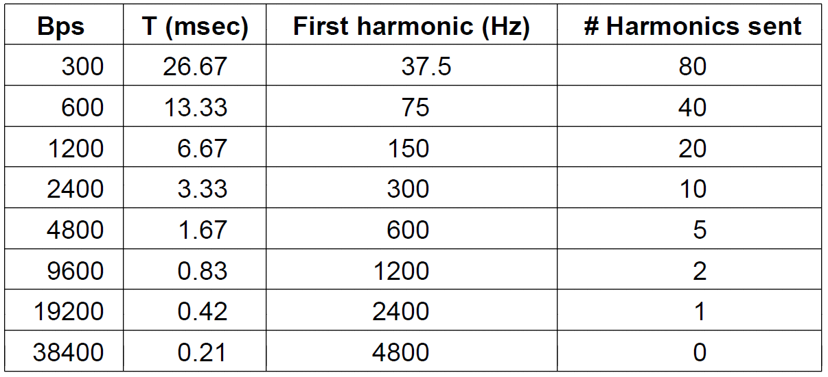
Bandwidth-Limited Signals (6)
Relation between data rate and harmonics for our example.

Slide 9
The Maximum Data Rate of a Channel
Nyquist’s theorem: B bandwidth, V discrete levels
Maximum data rate = 2 B log2V bits/sec
Shannon’s formula for capacity of a noisy channel
S/N signal-to-noise ratio

Slide 10
速率
速率即数据率(data rate)或称数据传输速率或比特率(bit rate)
▪单位时间（秒）传输信息（比特）量
▪计算机网络中最重要的一个性能指标
▪单位：b/s（或bps）、kb/s、Mb/s、Gb/s
▪k=10³、M=10⁶、G=10⁹
速率往往是指额定速率或标称速率

Slide 11
带宽
“带宽”(bandwidth)原本指信号具有的频带宽度，即最高频率与最低频率之差，单位是赫兹（Hz）
网络的“带宽”通常是数字信道所能传送的“最高数据率”，单位：b/s (bps)
常用的带宽单位:
▪k=10³、M=10⁶、G=10⁹
信噪比 S/N: 10 log10SNR,单位 dB

Slide 12
练习
一个电话系统 频率带宽 B=3.4kHz, SNR=10000( 40dB), 该信道最大的传输速率是多少。

Slide 13
Physical Media
Bit: propagates between transmitter/rcvr pairs
physical link: what lies between transmitter & receiver
guided media:
signals propagate in solid media: copper, fiber, coax
unguided media:
signals propagate freely, e.g., radio

Slide 14
Guided Transmission Media
Magnetic media
Twisted pairs
Coaxial cable
Power lines
Fiber optics

Slide 15
Magnetic Media
Write data onto magnetic media
Disks
Tapes
Data transmission speed
Never underestimate the bandwidth of a station wagon full of tapes hurtling down the highway.

Slide 16
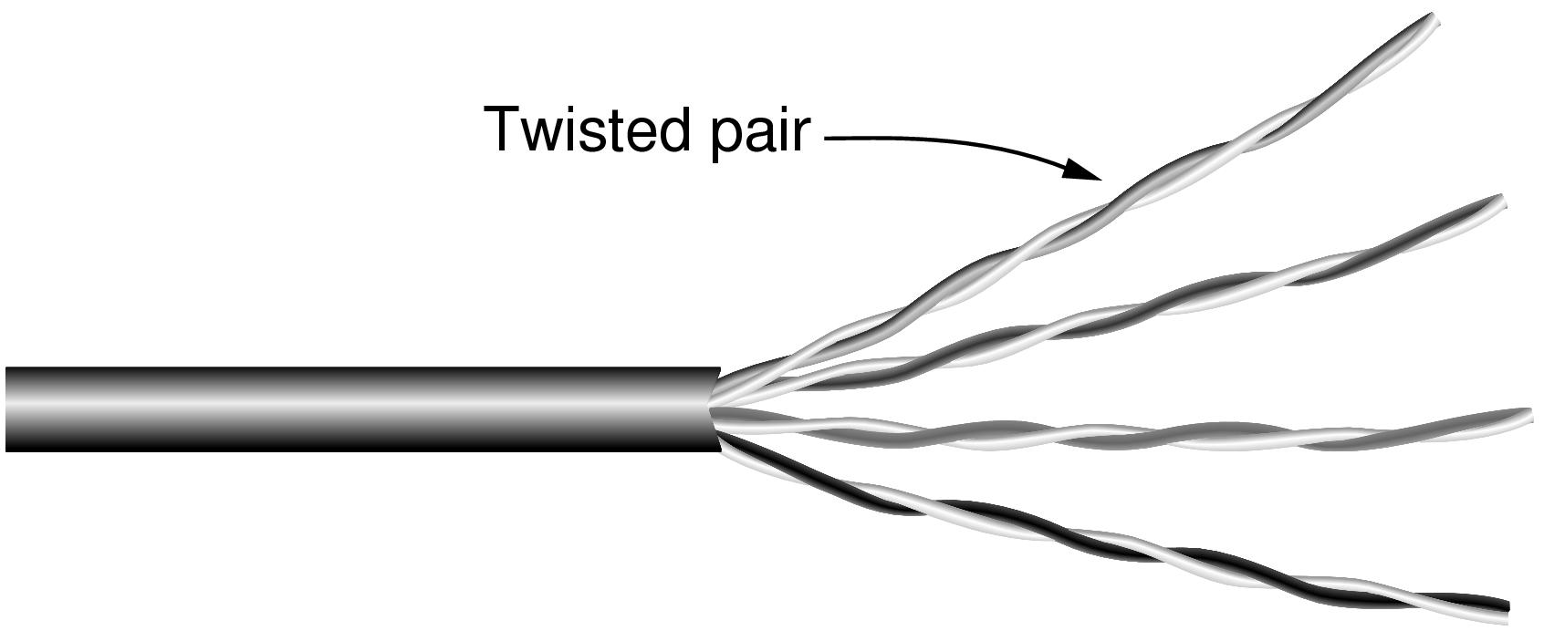
Twisted Pairs
Category 5 UTP cable with four twisted pairs

Slide 17
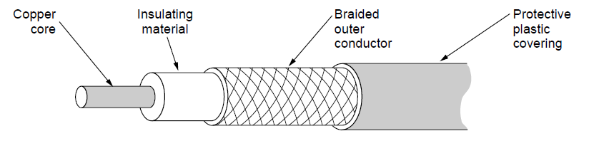
Coaxial Cable
A coaxial cable

Slide 18
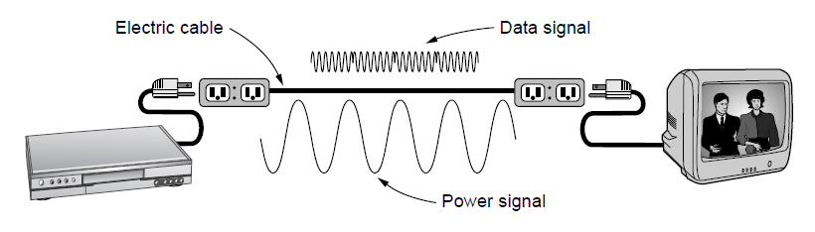
Power Lines
A network that uses household electrical wiring.

Slide 19
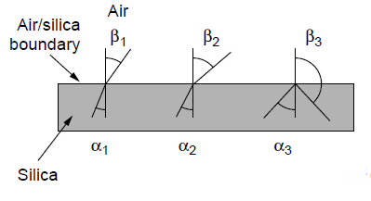
Fiber Optics (1)
Three examples of a light ray from inside a silica fiber impinging on the air/silica boundary at different angles.

Slide 20
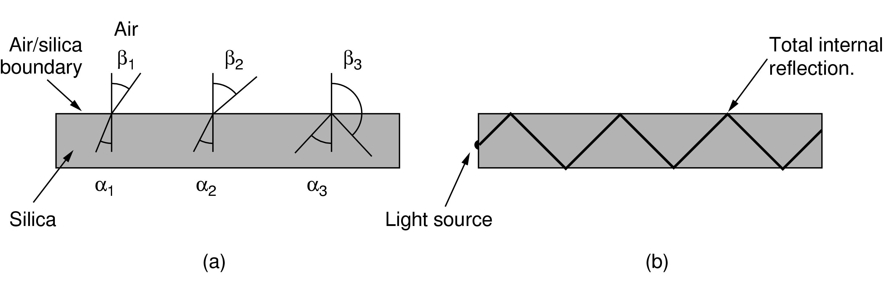
Fiber Optics (2)
Light trapped by total internal reflection.

Slide 21
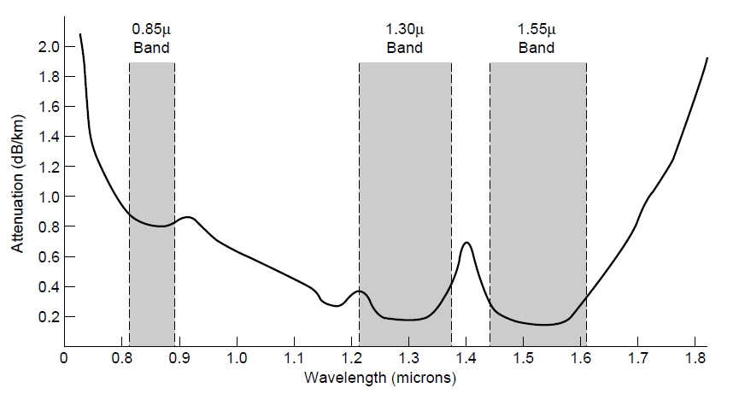
Transmission of Light Through Fiber
Attenuation of light through fiber in the infrared region

Slide 22
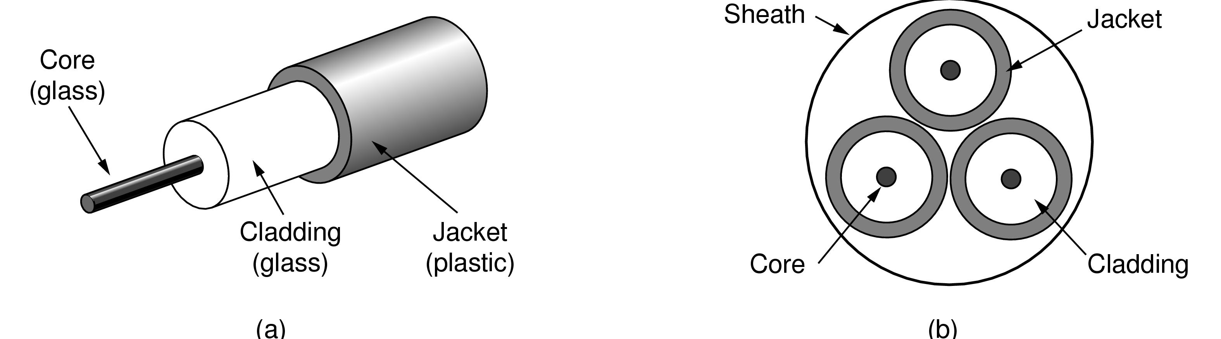
Fiber Cables (1)
Views of a fiber cable

Slide 23
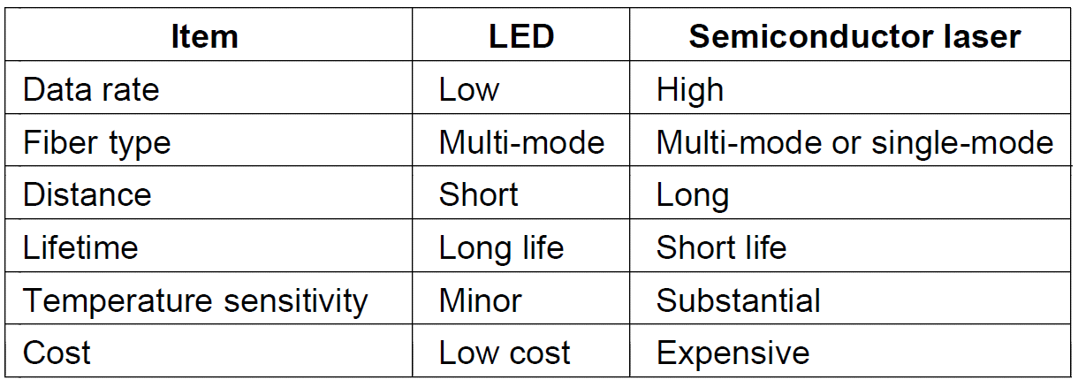
Fiber Cables (2)
A comparison of semiconductor diodes and LEDs as light sources

Slide 24
Physical media: cable, fiber
Coaxial cable:
two concentric copper conductors
bidirectional
baseband:
single channel on cable
legacy Ethernet
broadband:
multiple channels on cable
HFC
Fiber optic cable:
glass fiber carrying light pulses, each pulse a bit
high-speed operation:
high-speed point-to-point transmission (e.g., 10’s-100’s Gps)
low error rate: repeaters spaced far apart ; immune to electromagnetic noise

Slide 25
Wireless Transmission
The Electromagnetic Spectrum
Radio Transmission
Microwave Transmission
Infrared Transmission
Light Transmission

Slide 26
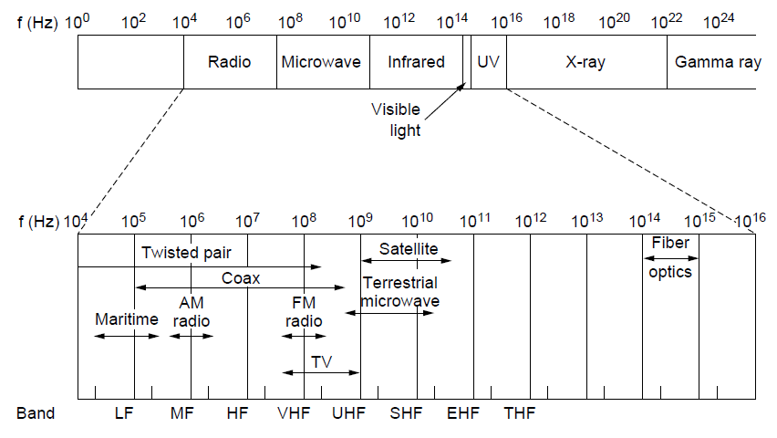
The Electromagnetic Spectrum (1)
The electromagnetic spectrum and its uses for communication

Slide 27
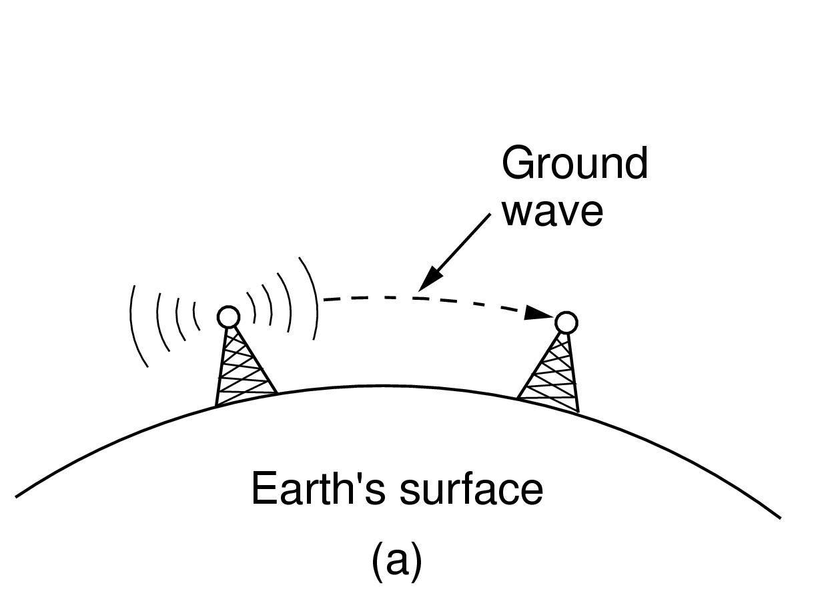
Radio Transmission (1)
In the VLF, LF, and MF bands, radio waves follow the curvature of the earth

Slide 28
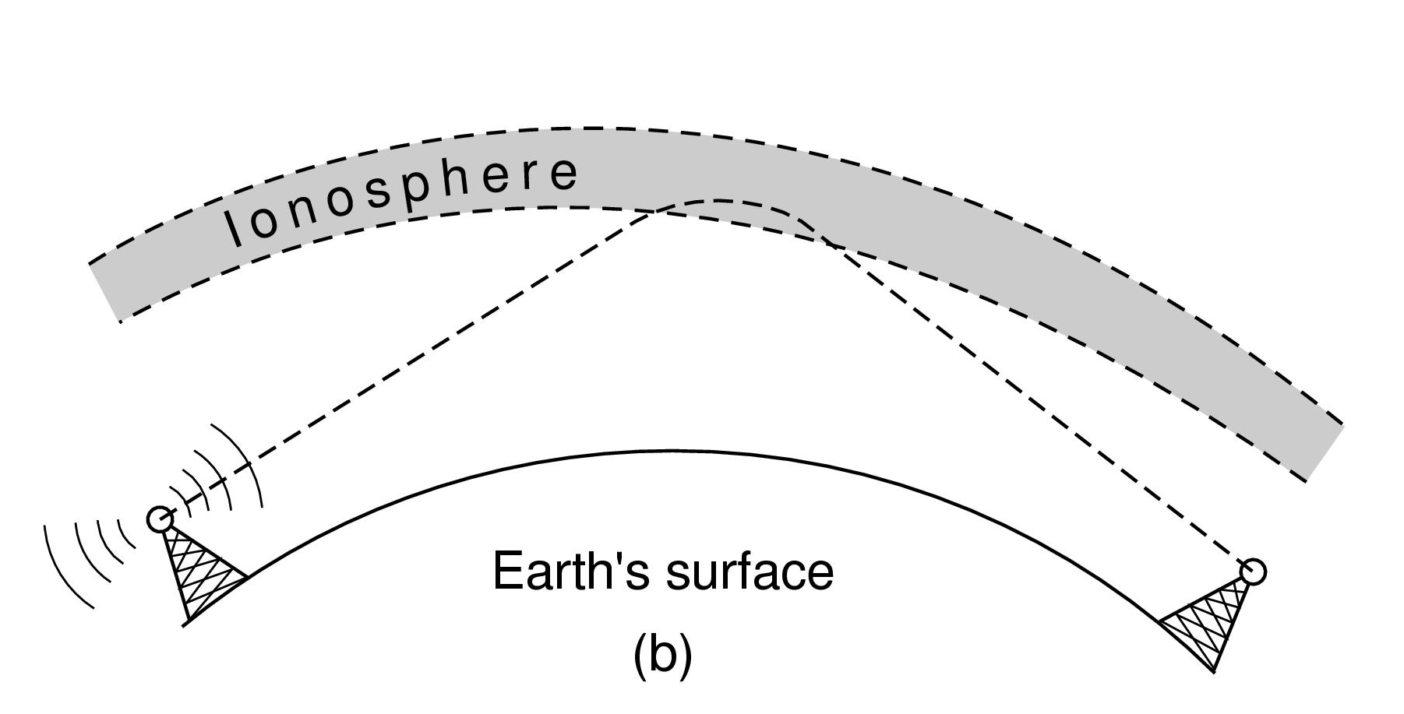
Radio Transmission (2)
In the HF band, they bounce off the ionosphere.

Slide 29
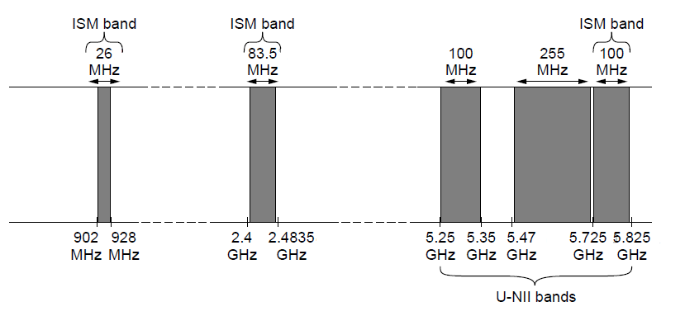
The Politics of the Electromagnetic Spectrum
ISM and U-NII bands used in the United States by wireless devices

Slide 30

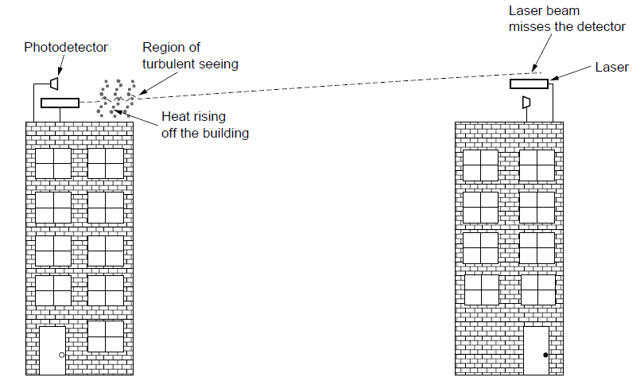
Light Transmission
Convection currents can interfere with laser communication systems. A bidirectional system with two lasers is pictured here.

Slide 31
Physical media: radio
signal carried in electromagnetic spectrum
no physical “wire”
Bidirectional (omni )
propagation environment effects:
reflection
obstruction by objects
interference

Slide 32
Communication Satellites
Geostationary Satellites
Medium-Earth Orbit Satellites
Low-Earth Orbit Satellites
Satellites Versus Fiber

Slide 33
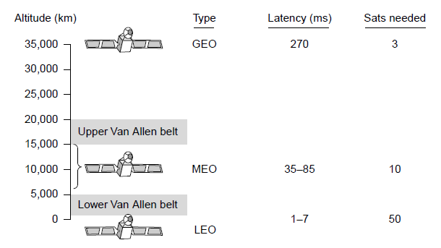
Communication Satellites
Communication satellites, some properties, including: altitude above earth, round-trip delay time, number of satellites for global coverage.

Slide 34
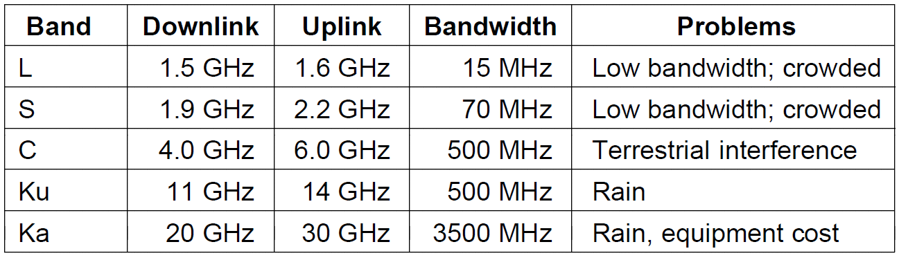
Geostationary Satellites (1)
The principal satellite bands

Slide 35
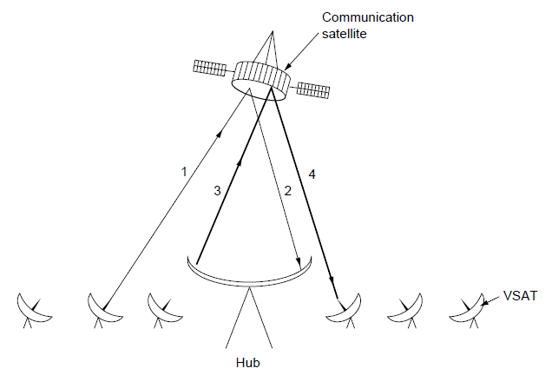
Geostationary Satellites (2)
VSATs using a hub.

Slide 36
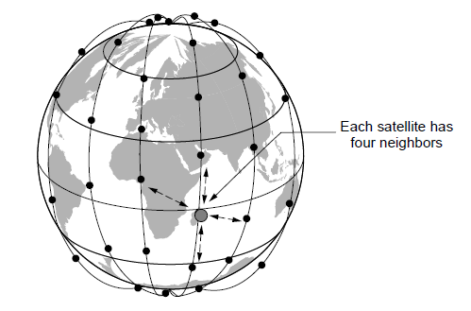
Low-Earth Orbit Satellites (1)
The Iridium satellites form six necklaces around the earth.

Slide 37
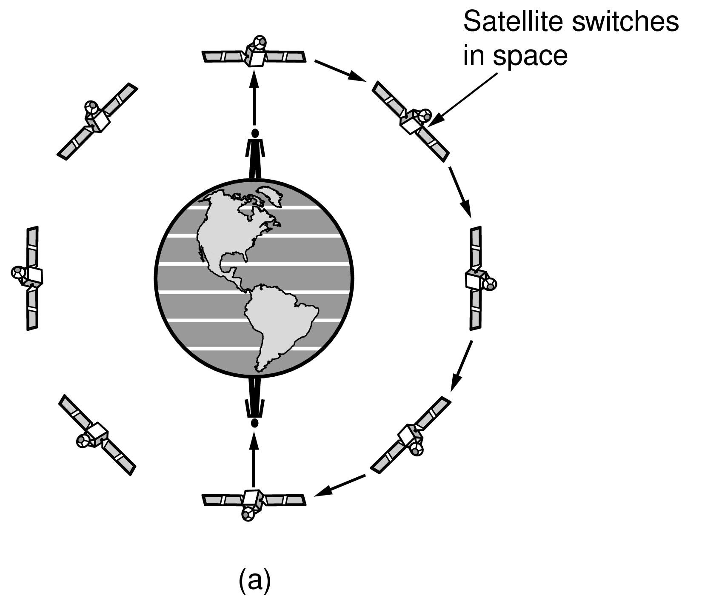
Low-Earth Orbit Satellites (2)
Relaying in space.

Slide 38
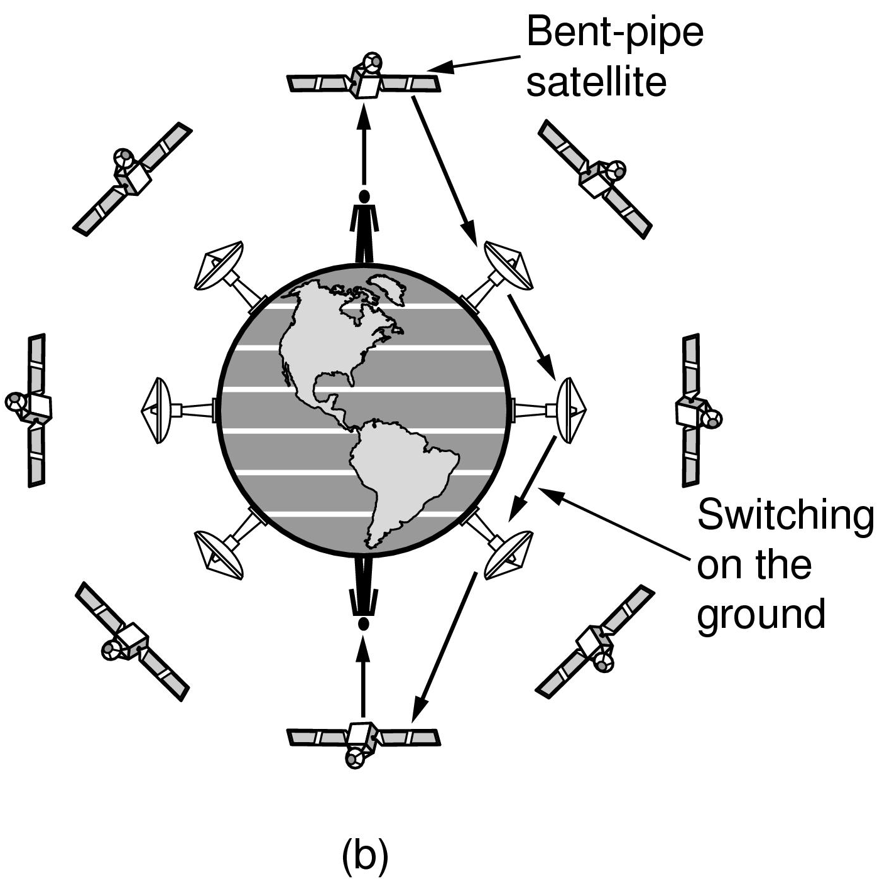
Low-Earth Orbit Satellites (3)
Relaying on the ground

Slide 39
Digital Modulation and Multiplexing
Baseband Transmission
Passband Transmission
Frequency Division Multiplexing
Time Division Multiplexing
Code Division Multiplexing

Slide 40
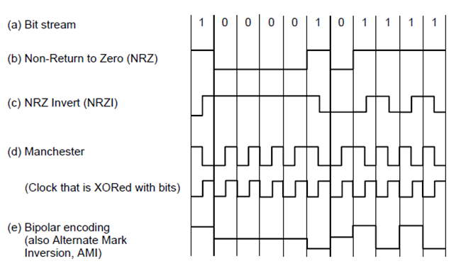
Baseband Transmission
Line codes: (a) Bits, (b) NRZ, (c) NRZI, (d) Manchester, (e) Bipolar or AMI.

Slide 41
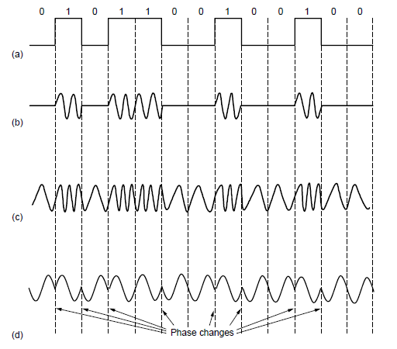
Passband Transmission (1)
(a) A binary signal. (b) Amplitude shift keying. (c) Frequency shift keying. (d) Phase shift keying.

Slide 42
FDM and TDM
Example:
4 users
FDM
frequency
time
TDM
frequency
time

Slide 43
FDM and TDM
FDM: common in the radio and television broadcast. Not in cellular telephony.
FDM not support a large user population.
TDM: can be dynamically allocated different bandwidth shared by giving them fewer or more time slots.
TDM: mobile station can use the time slots which it is not transmitting to do other jobs
TDM: mobile station less power than FDM
TDM: longer delay, synchronize problem.

Slide 44
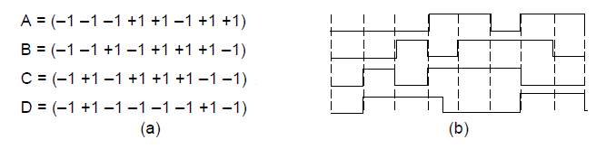
Code Division Multiplexing (1)
Chip sequences for four stations.
Signals the sequences represent

Slide 45
The Public Switched Telephone Network
Structure of the telephone system
Politics of telephones
Local loop: modems, ADSL, and fiber
Trunks and multiplexing
Switching

Slide 46
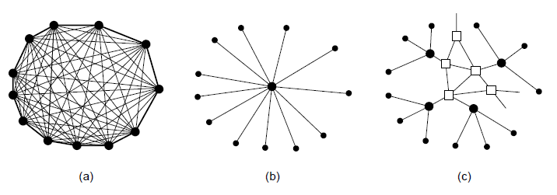
Structure of the Telephone System (1)
Fully interconnected network.
Centralized switch.
Two-level hierarchy.

Slide 47
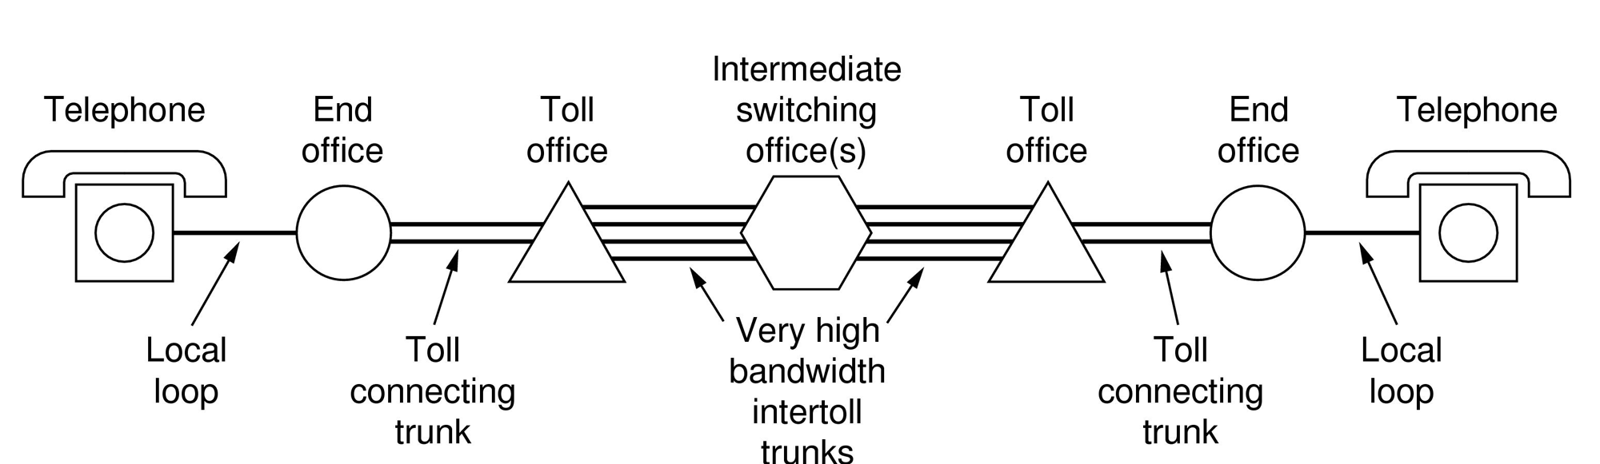
Structure of the Telephone System (2)
A typical circuit route for a long-distance call.

Slide 48
Structure of the Telephone System (3)
Major Components
Local loops analog twisted pairs to houses, businesses).
Trunks (digital fiber optic links between switching offices).
Switching offices (calls are moved from one trunk to another).

Slide 49
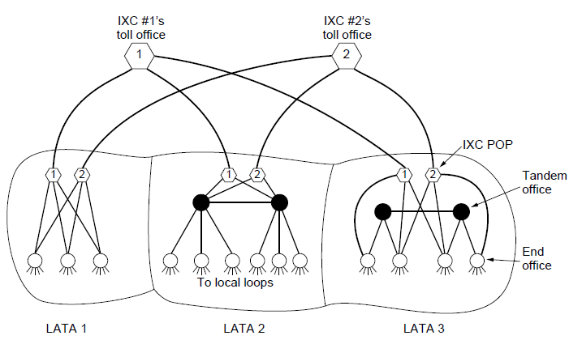
The Politics of Telephones
The relationship of LATAs, LECs, and IXCs. Circles are LEC switching offices. Hexagons belong to IXC whose number is in it.

Slide 50
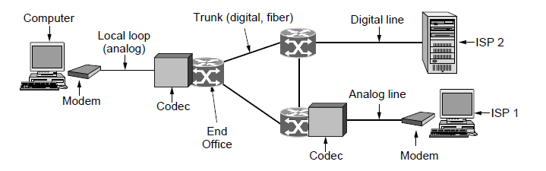
Telephone Modems
Use of both analog and digital transmission for computer -to-computer call. Conversion done by modems and codecs.

Slide 51
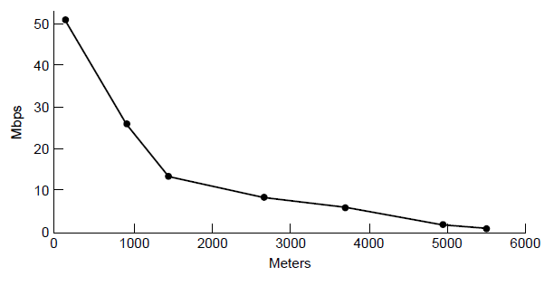
Digital Subscriber Lines (1)
Bandwidth versus distance over Category 3 UTP for DSL.

Slide 52
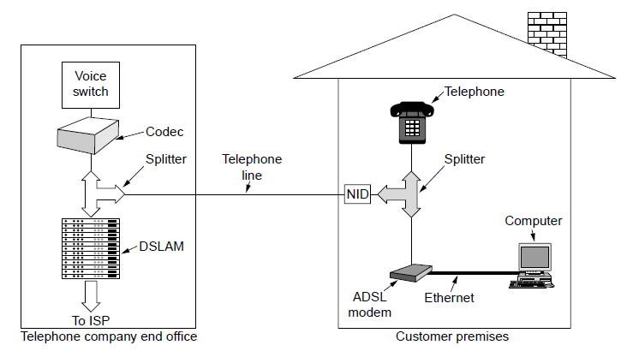
Digital Subscriber Lines (3)
A typical ADSL equipment configuration.

Slide 53
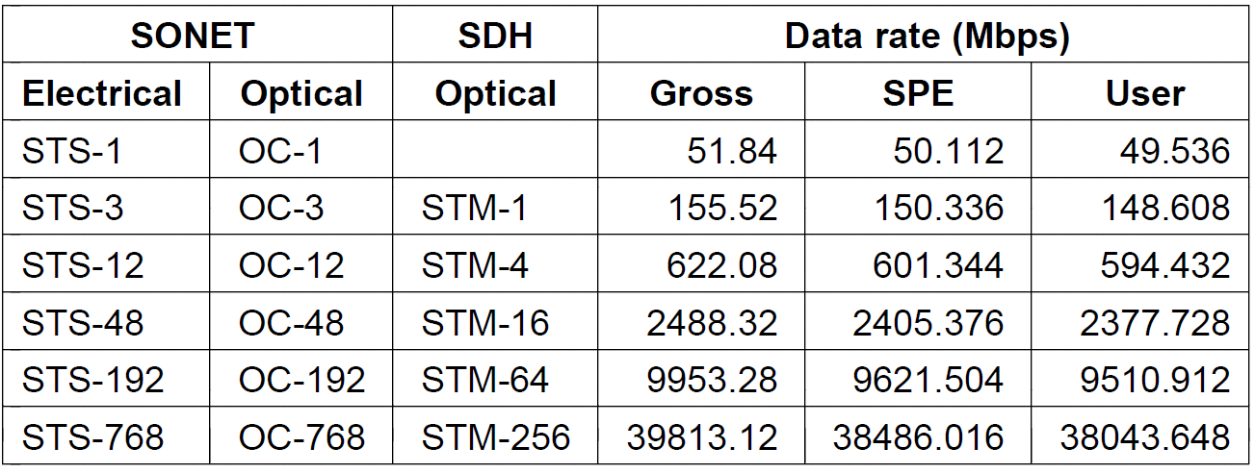
SONET/SDH (2)
SONET and SDH multiplex rates.

Slide 54
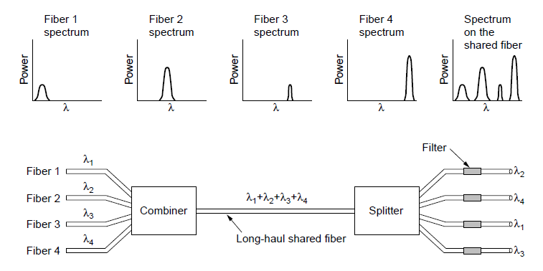
Wavelength Division Multiplexing
Wavelength division multiplexing

Slide 55
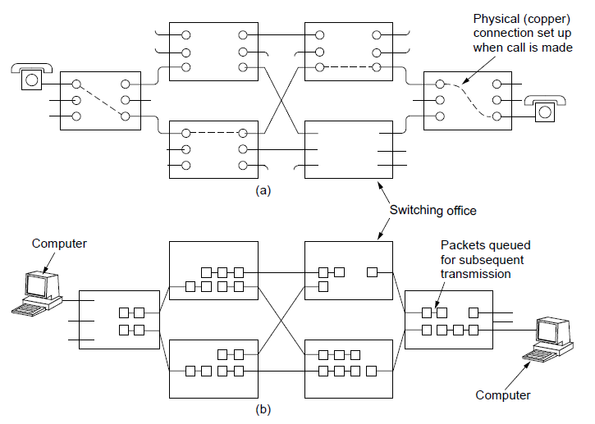
Circuit Switching/Packet Switching (1)
(a) Circuit switching. (b) Packet switching.

Slide 56
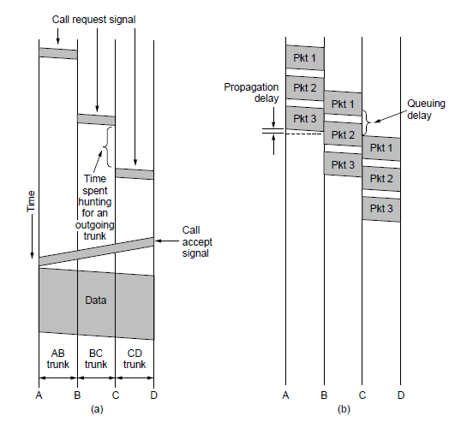
Circuit Switching/Packet Switching (2)
Timing of events in (a) circuit switching, (b) packet switching

Slide 57
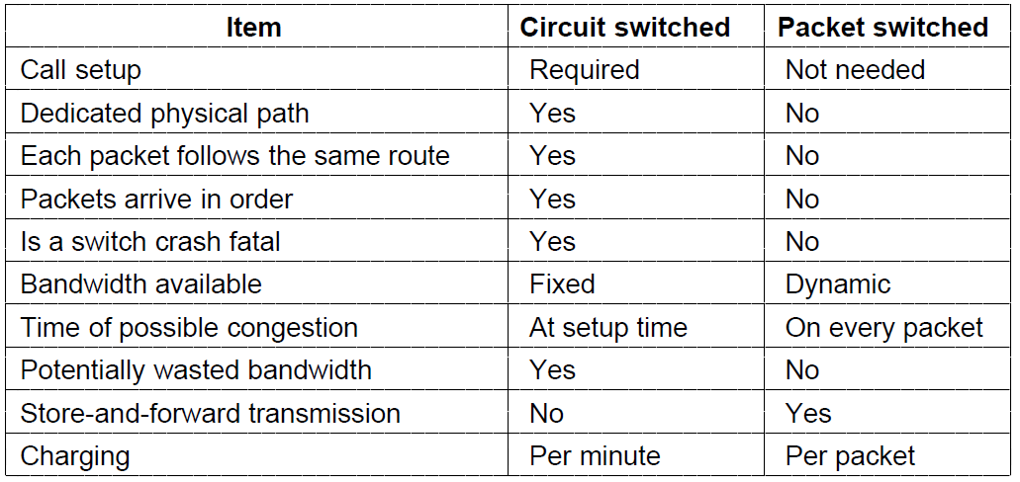
Circuit Switching/Packet Switching (3)
A comparison of circuit-switched and packet-switched networks.

Slide 58
Mobile Telephone System
First-Generation (1G) Mobile Phones Analog Voice
Second-Generation (2G) Mobile Phones Digital Voice
Third-Generation (3G) Mobile Phones Digital Voice + Data

Slide 59
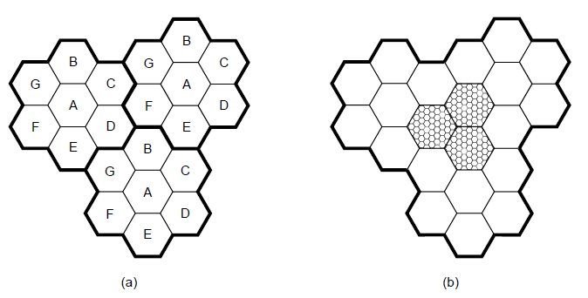
Advanced Mobile Phone System
(a) Frequencies are not reused in adjacent cells. (b) To add more users, smaller cells can be used.

Slide 60
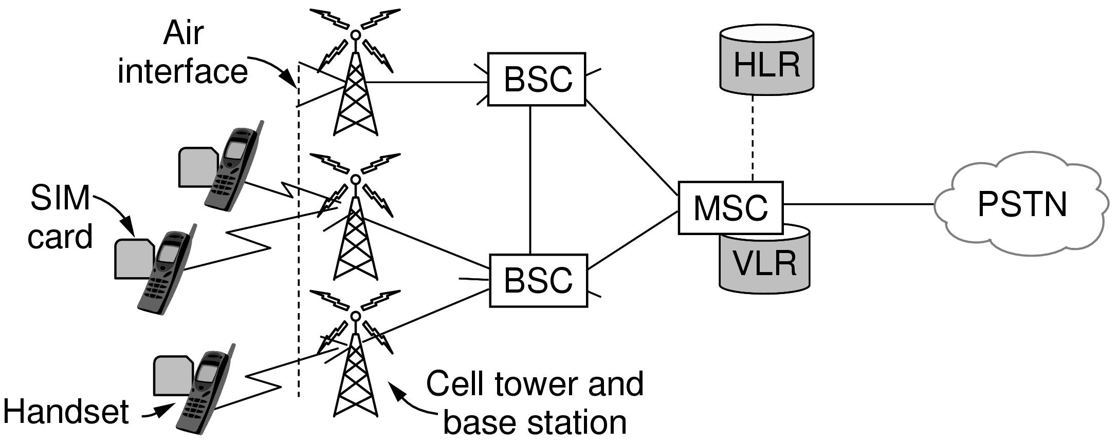
GSM—The Global System for Mobile Communications (1)
GSM mobile network architecture.

Slide 61
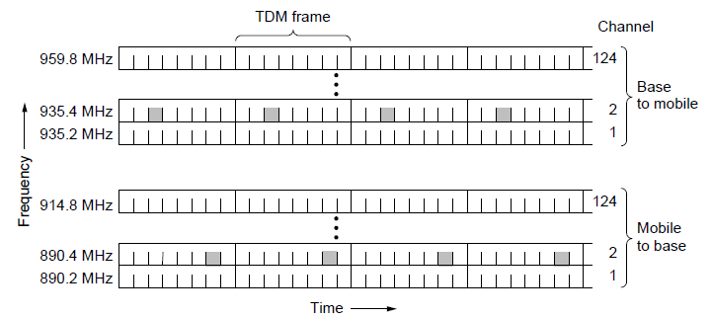
GSM—The Global System for Mobile Communications (2)
GSM uses 124 frequency channels, each of which uses an eight-slot TDM system.

Slide 62
Cable Television
Community antenna television
Internet over cable
Spectrum allocation
Cable modems
ADSL versus cable

Slide 63
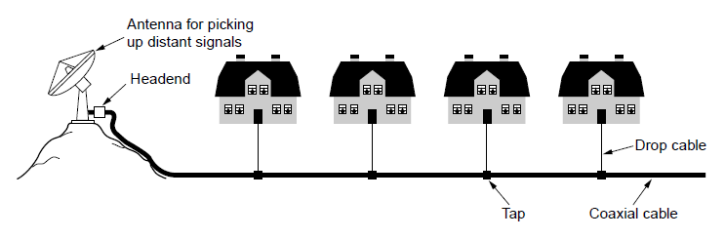
Community Antenna Television
An early cable television system

Slide 64
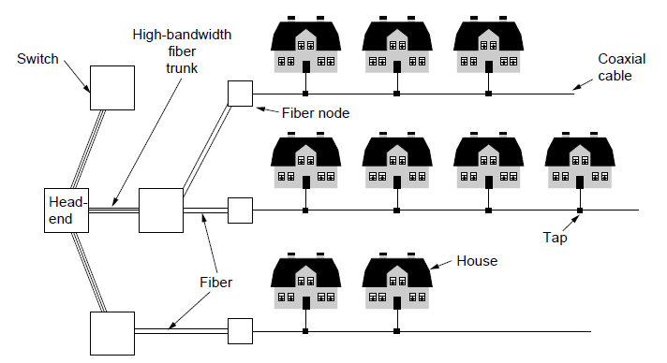
Internet over Cable (1)
Cable television

Slide 65
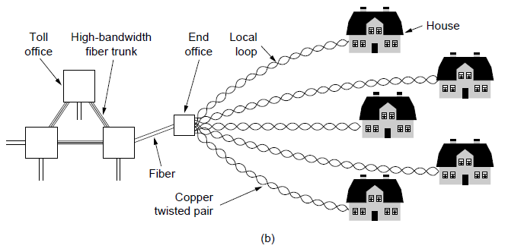
Internet over Cable (2)
The fixed telephone system.

Slide 66
End
Chapter 2

